Slide 1



Chapter 5 Link Layer
Computer Networking: A Top Down Approach 6th edition Jim Kurose, Keith Ross Addison-Wesley March 2012
A note on the use of these ppt slides:
We’re making these slides freely available to all (faculty, students, readers). They’re in PowerPoint form so you see the animations; and can add, modify, and delete slides (including this one) and slide content to suit your needs. They obviously represent a lot of work on our part. In return for use, we only ask the following:
If you use these slides (e.g., in a class) that you mention their source (after all, we’d like people to use our book!)
If you post any slides on a www site, that you note that they are adapted from (or perhaps identical to) our slides, and note our copyright of this material.
Thanks and enjoy! JFK/KWR
All material copyright 1996-2012
J.F Kurose and K.W. Ross, All Rights Reserved

Slide 2
Link layer, LANs: outline
5.1 introduction, services
5.2 error detection, correction
5.3 multiple access protocols
5.4 LANs
addressing, ARP
Ethernet
switches
VLANS
5.5 link virtualization: MPLS
5.6 data center networking
5.7 a day in the life of a web request

Slide 3

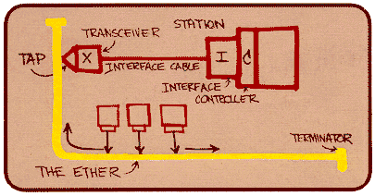
Ethernet
“dominant” wired LAN technology:
cheap $20 for NIC
first widely used LAN technology
simpler, cheaper than token LANs and ATM
kept up with speed race: 10 Mbps – 10 Gbps
Metcalfe’s Ethernet sketch

Slide 4




Ethernet: physical topology
bus: popular through mid 90s
all nodes in same collision domain (can collide with each other)
star: prevails today
active switch in center
each “spoke” runs a (separate) Ethernet protocol (nodes do not collide with each other)
switch
star
bus: coaxial cable

Slide 5

Ethernet frame structure
sending adapter encapsulates IP datagram (or other network layer protocol packet) in Ethernet frame
preamble:
7 bytes with pattern 10101010 followed by one byte with pattern 10101011
used to synchronize receiver, sender clock rates
type
preamble
dest.
address
source
address
data (payload)
CRC

Slide 6
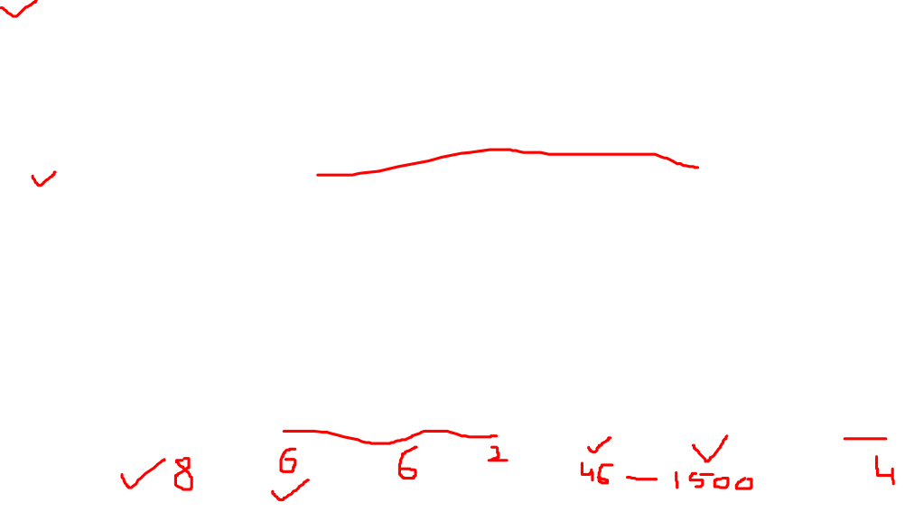
Ethernet frame structure (more)
addresses: 6 byte source, destination MAC addresses
if adapter receives frame with matching destination address, or with broadcast address (e.g. ARP packet), it passes data in frame to network layer protocol
otherwise, adapter discards frame
type: indicates higher layer protocol (mostly IP but others possible, e.g., Novell IPX, AppleTalk)
CRC: cyclic redundancy check at receiver
error detected: frame is dropped
type
preamble
dest.
address
source
address
data (payload)
CRC

Slide 7
Ethernet: unreliable, connectionless
connectionless: no handshaking between sending and receiving NICs
unreliable: receiving NIC doesnt send acks or nacks to sending NIC
data in dropped frames recovered only if initial sender uses higher layer rdt (e.g., TCP), otherwise dropped data lost
Ethernet’s MAC protocol: unslotted CSMA/CD wth binary backoff

Slide 8
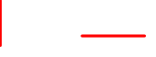
802.3 Ethernet standards: link & physical layers
many different Ethernet standards
common MAC protocol and frame format
different speeds: 2 Mbps, 10 Mbps, 100 Mbps, 1Gbps, 10G bps
different physical layer media: fiber, cable
application
transport
network
link
physical
MAC protocol
and frame format
100BASE-TX
100BASE-T2
100BASE-FX
100BASE-T4
100BASE-SX
100BASE-BX
copper (twister
pair) physical layer
fiber physical layer

Slide 9
Link layer, LANs: outline
5.1 introduction, services
5.2 error detection, correction
5.3 multiple access protocols
5.4 LANs
addressing, ARP
Ethernet
switches
VLANS
5.5 link virtualization: MPLS
5.6 data center networking
5.7 a day in the life of a web request

Slide 10
Ethernet switch
link-layer device: takes an active role
store, forward Ethernet frames
examine incoming frame’s MAC address, selectively forward frame to one-or-more outgoing links when frame is to be forwarded on segment, uses CSMA/CD to access segment
transparent
hosts are unaware of presence of switches
plug-and-play, self-learning
switches do not need to be configured

Slide 11

Switch: multiple simultaneous transmissions
hosts have dedicated, direct connection to switch
switches buffer packets
Ethernet protocol used on each incoming link, but no collisions; full duplex
each link is its own collision domain
switching: A-to-A’ and B-to-B’ can transmit simultaneously, without collisions
A
C’
B
6
1
2
5
4
3
B’
C
A’
switch with six interfaces
(1,2,3,4,5,6)

Slide 12

Switch forwarding table
Q: how does switch know A’ reachable via interface 4, B’ reachable via interface 5?
A
C’
B
A: each switch has a switch table, each entry:
(MAC address of host, interface to reach host, time stamp)
looks like a routing table!
6
1
2
5
4
3
B’
C
A’
Q: how are entries created, maintained in switch table?
something like a routing protocol?
switch with six interfaces
(1,2,3,4,5,6)

Slide 13

Switch: self-learning
Source: A
Dest: A’
switch learns which hosts can be reached through which interfaces
when frame received, switch “learns” location of sender: incoming LAN segment
records sender/location pair in switch table
A
A A’
C’
B
6
1
2
5
4
3
B’
C
A’
MAC addr interface TTL
A
1
60
Switch table
(initially empty)

Slide 14
Switch: frame filtering/forwarding
when frame received at switch:
1. record incoming link, MAC address of sending host
2. index switch table using MAC destination address
3. if entry found for destination then {
if destination on segment from which frame arrived then drop frame
else forward frame on interface indicated by entry
}
else flood /* forward on all interfaces except arriving
interface */

Slide 15

Self-learning, forwarding: example
Source: A
Dest: A’
A
A A’
frame destination, A’, locaton unknown:
flood
C’
B
destination A location known:
6
1
2
A A’
A A’
A A’
A A’
selectively send
on just one link
A A’
5
4
3
B’
C
A’ A
A’
MAC addr interface TTL
A
1
60
switch table
(initially empty)
A’
4
60

Slide 16


Interconnecting switches
switches can be connected together
S₄
S₁
S₃
A
S₂
F
I
B
C
D
E
G
H
Q: sending from A to G - how does S₁ know to forward frame destined to F via S₄ and S₃?
A: self learning! (works exactly the same as in single-switch case!)

Slide 17

Self-learning multi-switch example
Suppose C sends frame to I, I responds to C
S₄
S₁
S₃
A
S₂
F
I
B
C
D
E
G
H
Q: show switch tables and packet forwarding in S₁, S₂, S₃, S₄

Slide 18

Institutional network
mail server
to external
network
router
web server
IP subnet

Slide 19
Switches vs. routers
application
transport
network
link
physical
both are store-and-forward:
routers: network-layer devices (examine network-layer headers)
switches: link-layer devices (examine link-layer headers)
both have forwarding tables:
routers: compute tables using routing algorithms, IP addresses
switches: learn forwarding table using flooding, learning, MAC addresses
datagram
frame
link
physical
frame
switch
network
link
physical
datagram
frame
application
transport
network
link
physical

